Slide 1
Integrated Web-based Inventory Management System for Academic Institutions
Mohammad Harun-Or-Rashid (Roll: 23214131)
Md. Musa Kalimullah (Roll: 23214118)
Department of Computer Science and Engineering
Islamic University Bangladesh
Dr. Md. Habibur Rahman
Associate Professor
Department of Computer Science and Engineering Islamic University Bangladesh

Slide 2
Outline
Background.
System Analysis.
System Design.
System Implementation & Evaluation.
Conclusion.
2

Slide 3



Motivation
Many organization or academic institutions has many assets but they have no integrated Inventory Management System system to instantly know what is the condition of their assets
If an item is stolen, they don’t know it.
Many organization or institutions has many assets such as Computer, Printer, Photocopy Machine, laptop bag, Chair, Table. But they maintain manual system to count their assets. Even If anyone take any item such as laptop for COVID situation in home for Work from home office, They don’t know who took which laptop. For this they need use manual filing system to count their assets.
3

Slide 4
Contribution
The purpose of the Inventory Management System is to maintain the inventory related information and all transactions of inventory items with dynamic item configuration for any organization or academic institutions.
Inventory Management System will provide unique opportunity to get more accurate picture of current inventory status. The target of this software is to reduce the manual filing and record-keeping process for asset management system.
When inventory items distribution process is maintain through manual filing process then there is big possibility of mistakes. So Inventory System reduces mistakes through dynamic stock management report.
Our Inventory Management System will have dynamic Item configuration with category wise and current stock report.
4

Slide 5
Related Works
1. “bdtask” Inventory Management System.
2. Odoo ERP Inventory Management System.
3. BASE IT Inventory Management System.
4. Square Inventory Management System.
5. Zoho Inventory Management System
5

Slide 6
Outline
Background.
System Analysis.
System Design.
System Implementation & Evaluation.
Conclusion
6

Slide 7
Problem & Solution Analysis
The problem Statement
Many academic institution has many assets but they don’t know what is the condition of their assets or how many assets are their. For this they need to manually count their assets.
The Solution
The Inventory Management System is complete solution to mange asset distribution flow and It has various report to know the current stock status report, Item Information, Item requisition etc.
Stakeholders
Inventory Manager, Employee, Teacher of institution.
User Roles
Multiple type of user roles have to be created for the better accessing end user through the system.
7

Slide 8
The Vision Statement
For | Academic Institutions
Who | Have difficulty in asset distribution
The Integrated Web-based Inventory Management System for Academic Institutions | is a Web-based bilingual application with Bangla & English
That | provides the ability to distribute Items among employee
Unlike | Currently available systems that have poor interface or many organization have no integrated system.
Our product | Our Inventory Management System is custom dynamic and Interactive user interface to properly distribute Item among Teachers or other employee and can find stock report
8

Slide 9
Actor & Features
The Actor
Admin, Inventory Manager, Employee, Student
List of Features
1. Application will be bilingual.
2. Dynamic user management system, User Role and Permission management system
3. Employee information
4. Item categories configuration, Dynamic Item configuration.
5. Supplier information, Item purchase from supplier.
6. Item request system, Requested Item approval process.
7. Allocate requested item to employee, Return Item to Inventory manager.
8. Stock Report.
9. Asset location (Room) wise Item stock report.
10. User activity report .
11. All report can be download as PDF, Word or Excel format.
9

Slide 10
Release Phase
Phase 1 | Phase 2 | Phase 3
Inventory Management System template design. Completed database design. Fixing sidebar for different type of role Responsive design Registration Login Sign out Forget password | Employee information setup. User’s role and permission system setup Both Bangla and English language switcher in whole application Fixing Architecture and make UI mobile friendly Main dashboard design. Develop user activity report. Common setup data configuration setup Item categories setup Developed Item setup Supplier information setup. | Developed Item receive from supplier scope. Developed Item request system Developed Approval process on requested item. Developed Item receive scope. Developed Item return scope Developed Stock report Asset location wise stock report Bug fixing Incorporate feedback.
10

Slide 11
Outline
Background.
System Analysis.
System Design.
System Implementation & Evaluation.
Conclusion
11

Slide 12
Collecting Data in the Problem Domain
To understand the problem of Inventory Management system that we are dealing with, we can adopt the following techniques
– Analysis Asset management system in academic institution
– Questionnaire
– Experimentation by building a prototype
– Observation
– Document inspection
– User story
12

Slide 13
User Story
As a Admin I need Access dashboard So that Monitoring the data.
As a registered user, I am required to login so that I can access the system.
As a forgetful user, I can request a password reminder I can login if I forgot mine.
As a teacher, I want to request for an Item so that I can use that Item.
As an Inventory Manager, I want to receive purchased Item from supplier so that I can view stock report easily.
As a department chairman, I want to see stock report so that I can now the current asset distribution.
As an Admin, I want to add Item Category so that I can use that in item setup.
As an Admin, I want to add Item information so that I can get item wise report.
As an Inventory Manager, I want to allocate item to employee so that An employee can use item
13

Slide 14
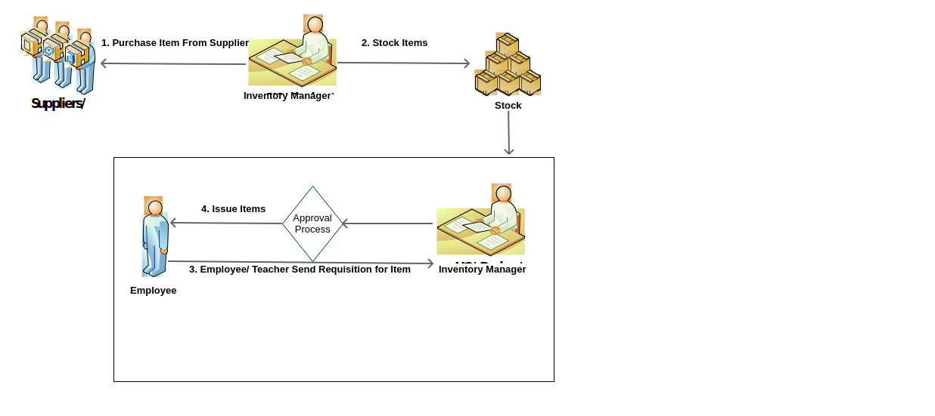
Data Flow Diagram
14

Slide 15
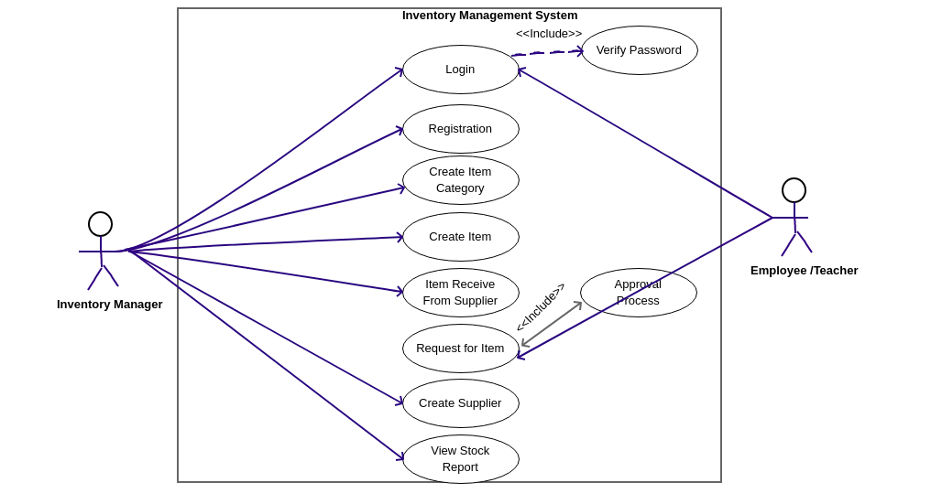
Use Case Diagram
15

Slide 16
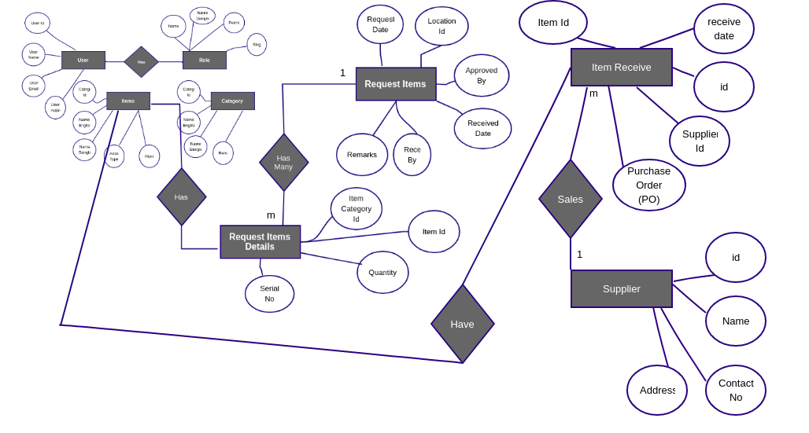
ER-Diagram
16

Slide 17
Outline
Background.
System Analysis.
System Design.
System Implementation & Evaluation.
Conclusion
17

Slide 18
Development Technology
Purpose | Tools & Technologies
Backend Programming | PHP, PHP Laravel MVC Framework
Web Server | Apache
Database | MySQL
Front-End | HTML, CSS, JavaScript, Jquery, Bootstrap
Operating System | Windows, Linux, MacOS
Browser | Firefox, Google Chrome, Opera, Safari
Design | UML, Pencil, Photoshop etc.
18

Slide 19
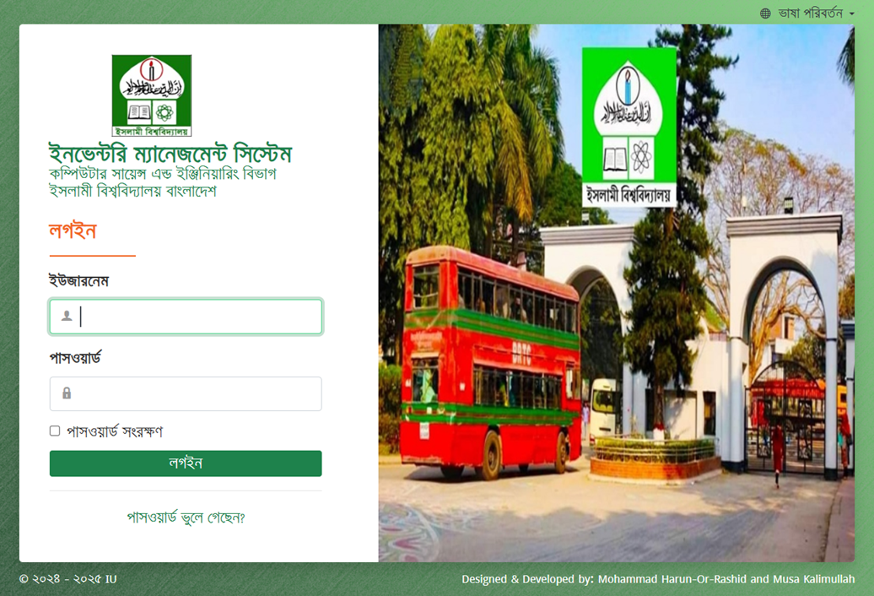
Application Screenshot
Login Screen
19

Slide 20
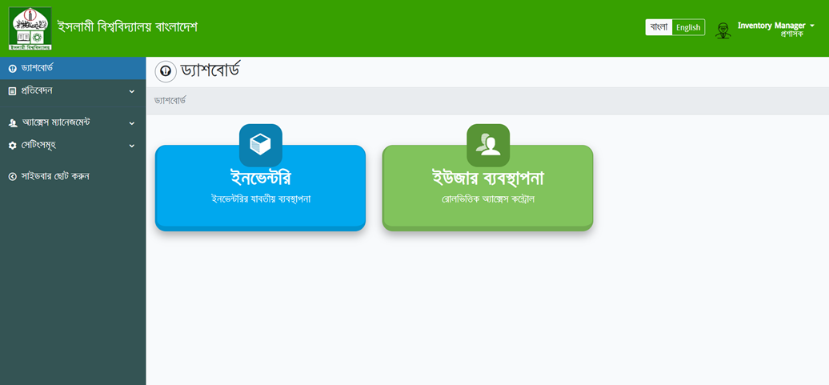
Dashboard
20

Slide 21
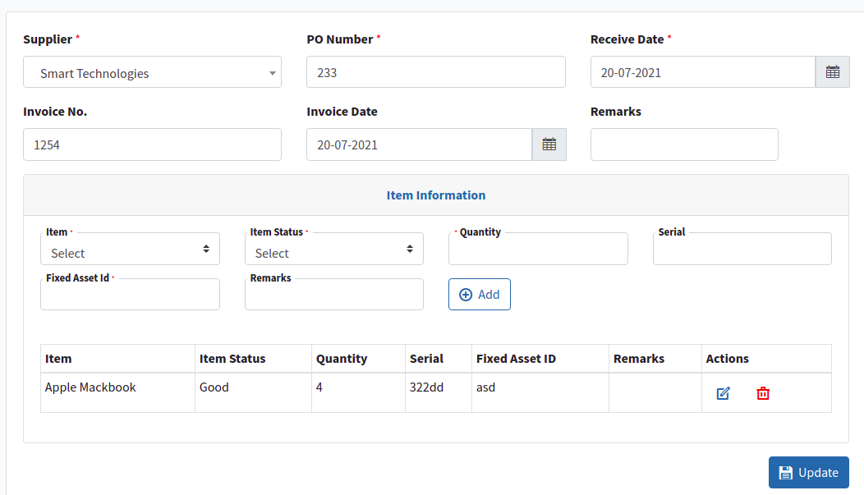
Item Receive From Supplier
21

Slide 22
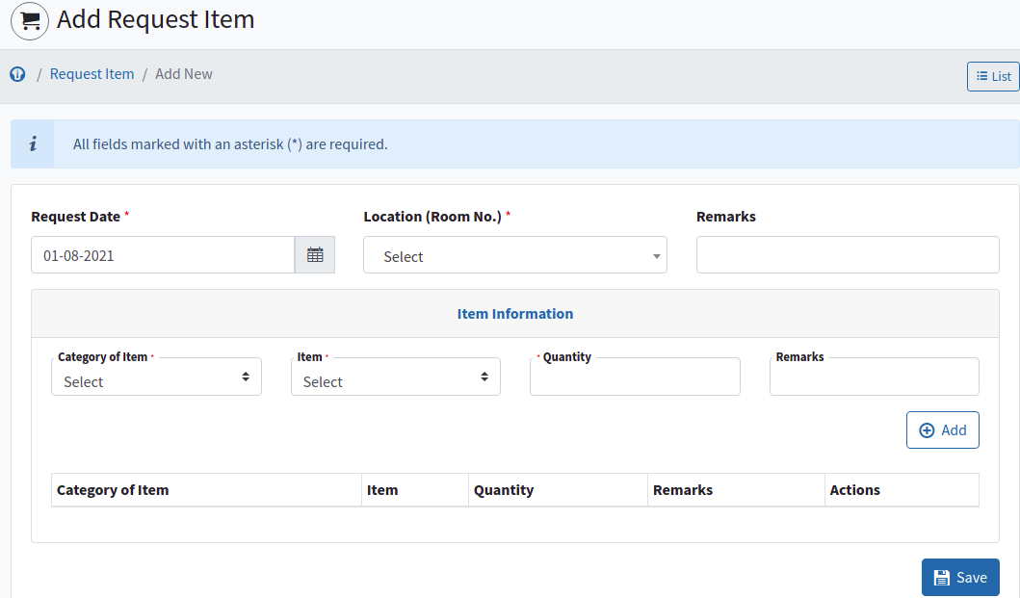
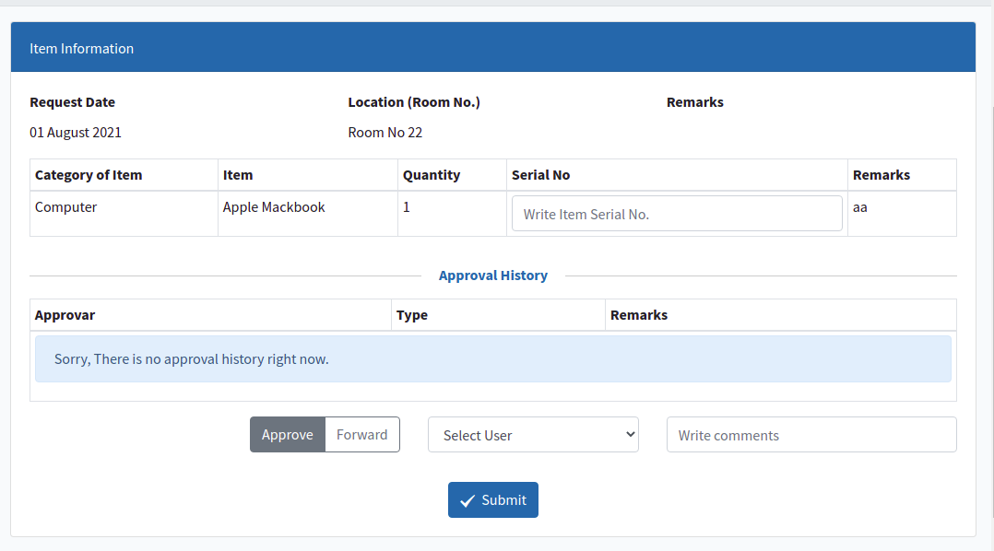
Request for An Item & Approval Process
22

Slide 23
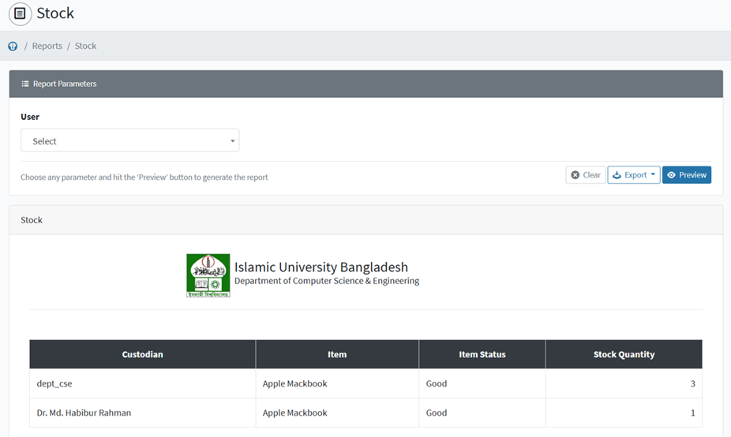
Stock Report
23

Slide 24
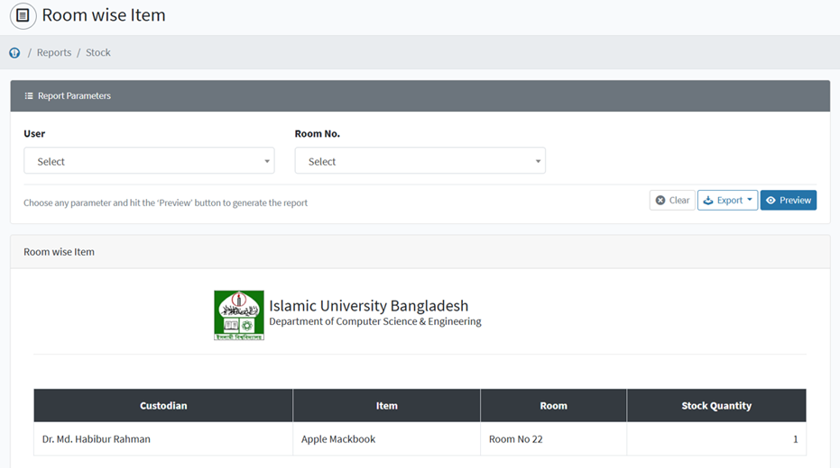
Stock Report (Location Wise)
24

Slide 25
Outline
Background.
System Analysis.
System Design.
System Implementation & Evaluation.
Conclusion
25

Slide 26
Conclusion
Finally, Developed Inventory Management System(IMS) will be helpful for any academic institution to manage asset distribution.
Future Work
There are many more scope to improve in the application. It’s not possible to improve all the best at the first attempt. In this application also, there are so many scope to improve. Also the user experience will be considered. The most important future work that I’ll do.
Item disposal Information
Notification system added to the system
Item transfer from One department to another department.
Item transfer receive from another department
26

Slide 27
Project Demo
27

Slide 28
Thank You
28

